Slide 1
Workshop: Transcriptomics/Proteomics Analysis
9 August 2023

Slide 2
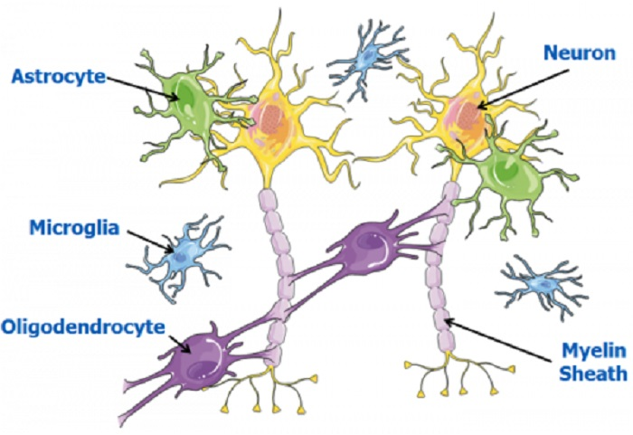
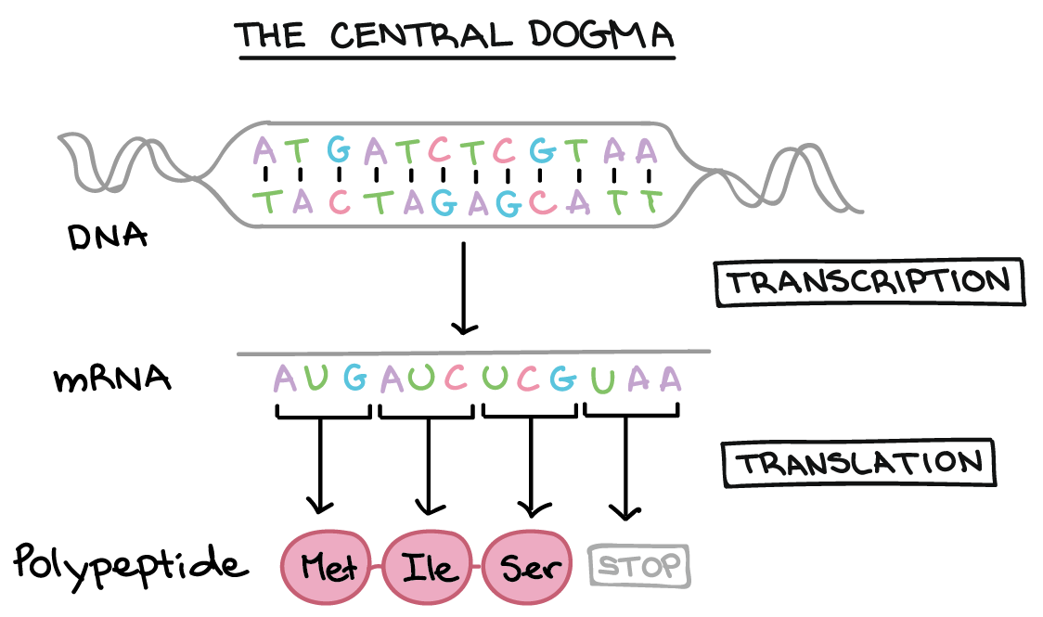
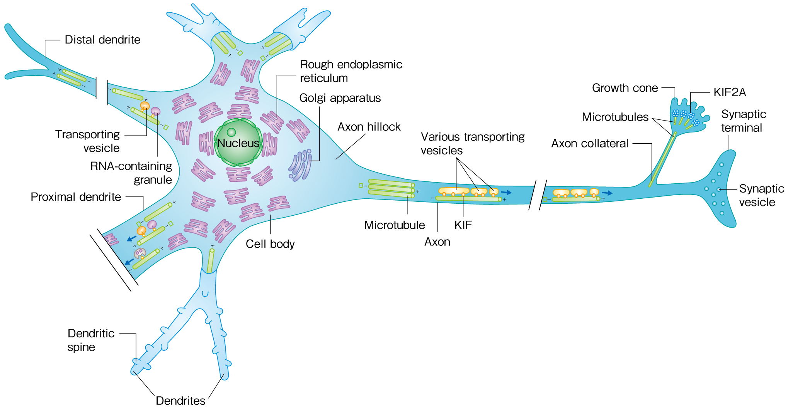
Goal: molecular profiling of brain cells
Khan Academy
Hirokawa Lab, 2018
Objective: Quantify mRNA or protein levels in brain tissue

Slide 3
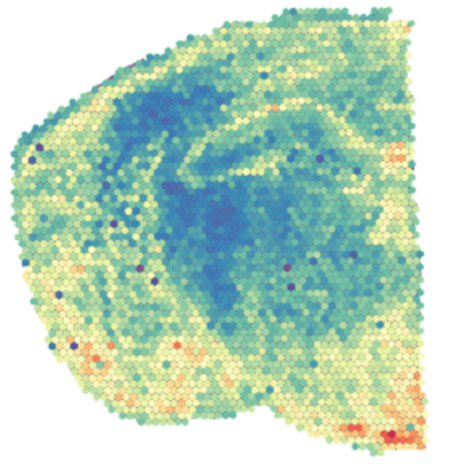
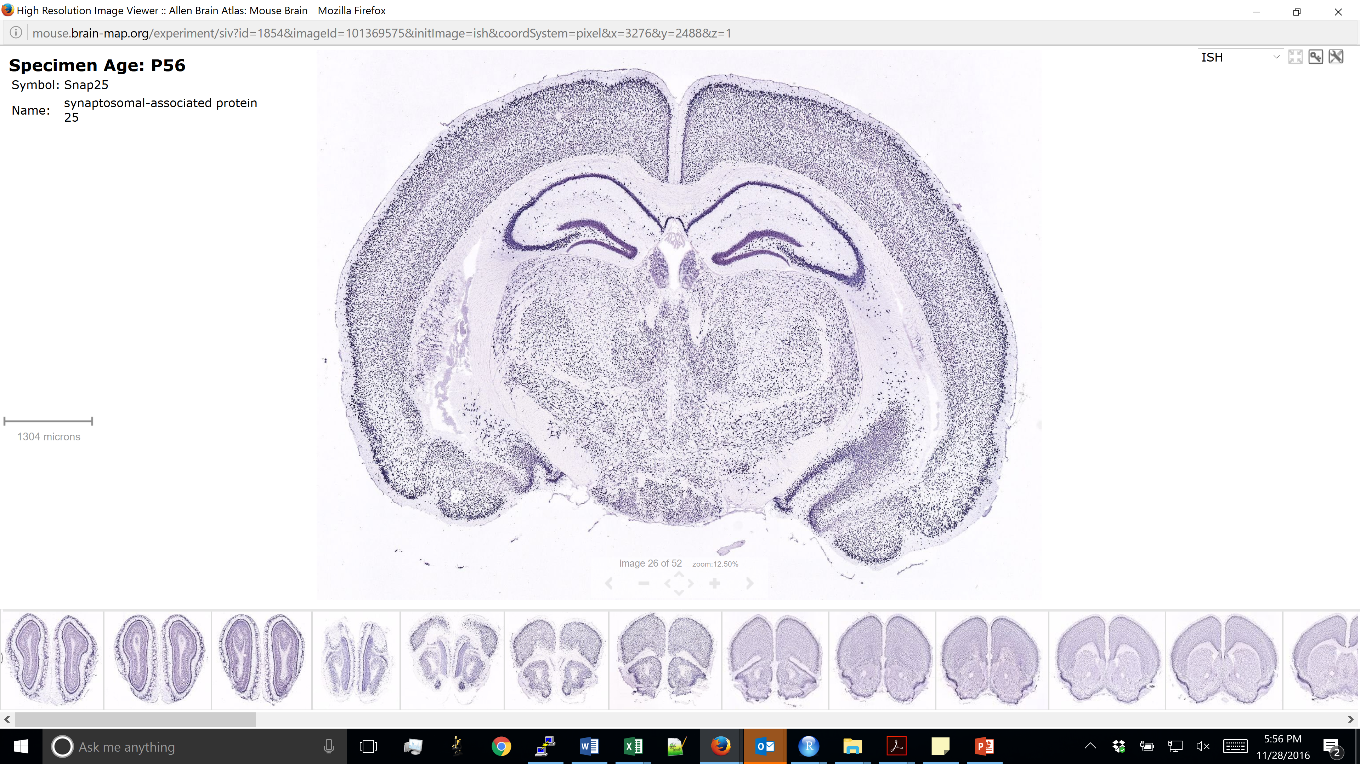
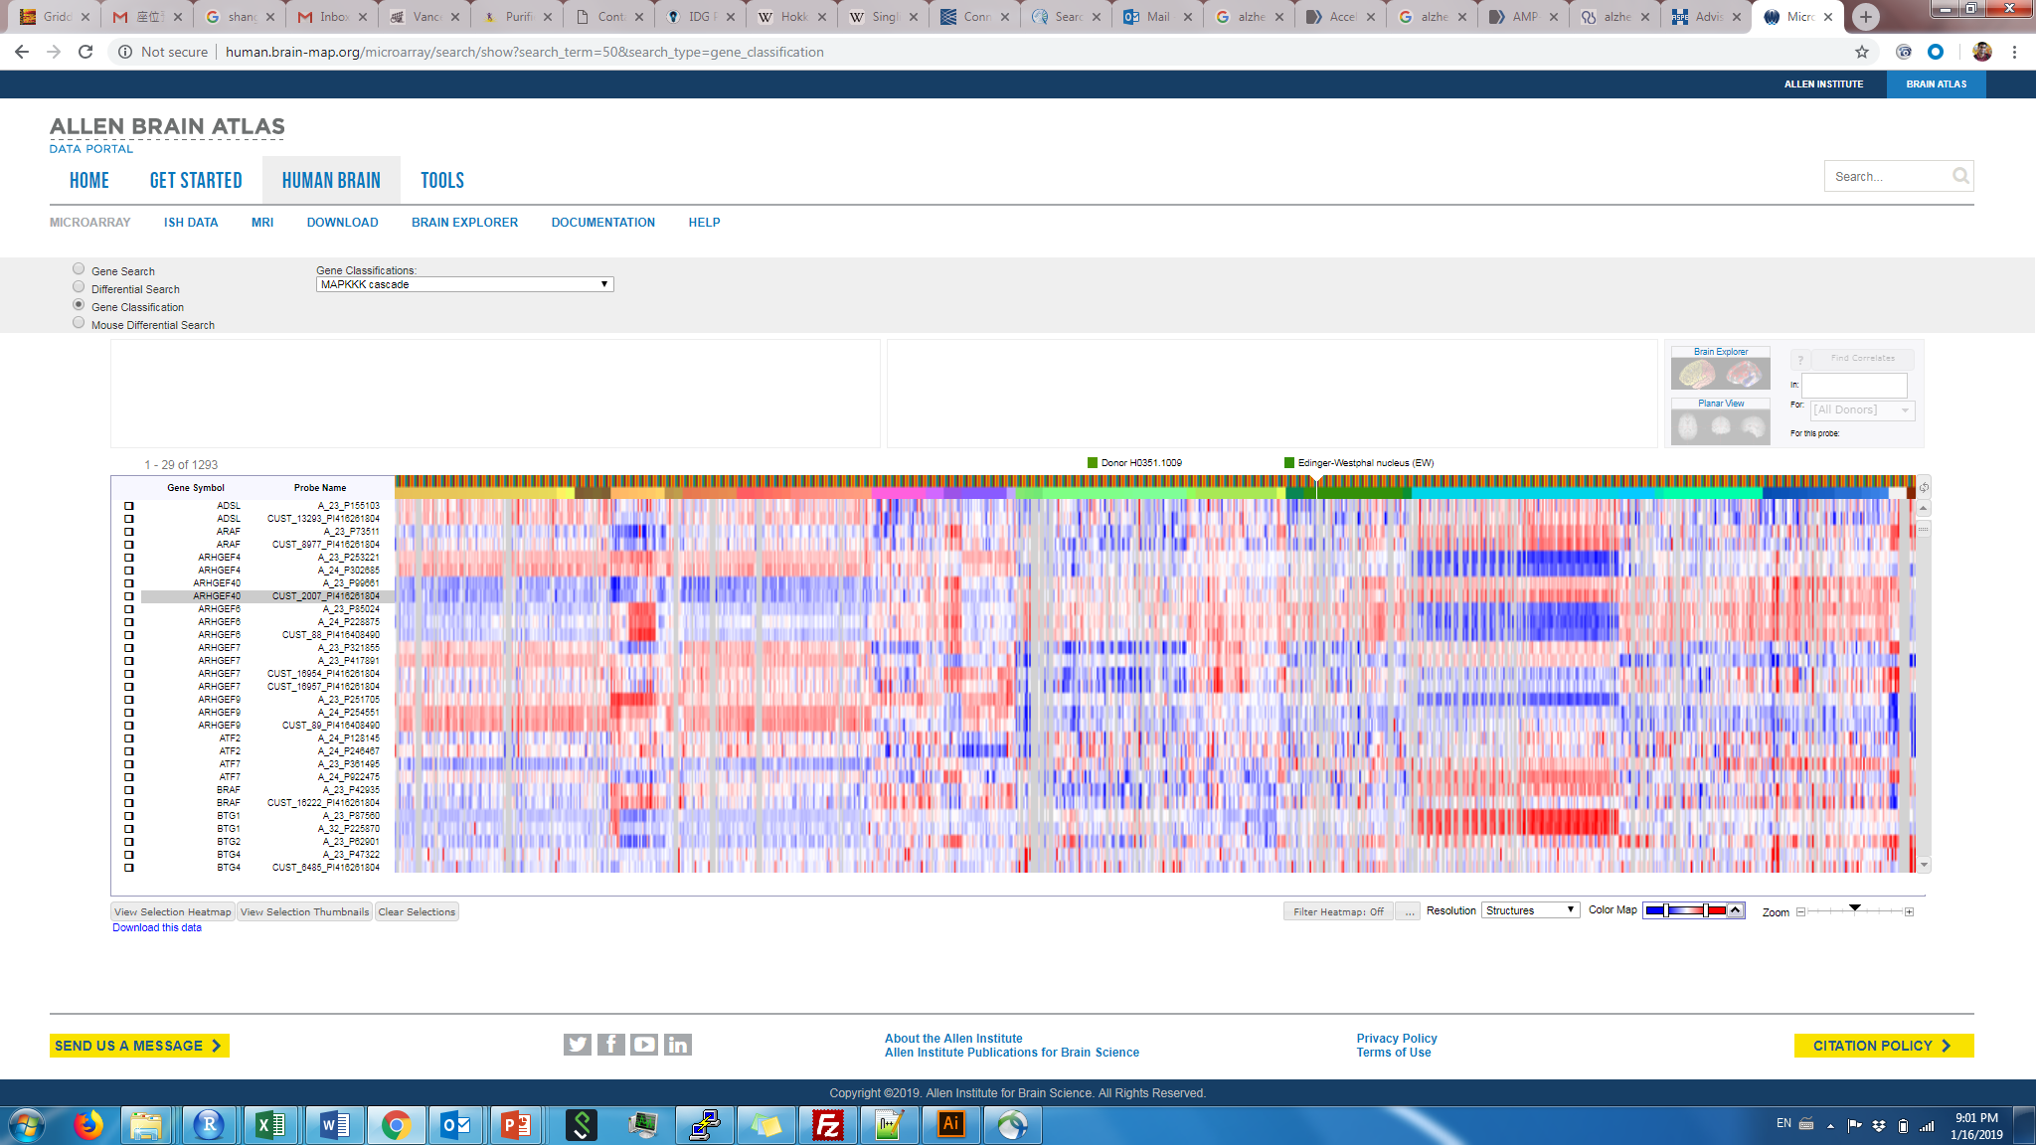
Recall: Methods to acquire molecular data
Method | ISH/IHC | RNA-sequencing
# of genes/proteins at once | ~1 – 5 (~500 with advanced methods) | ~10,000 – 20,000
Single-cell resolution | Yes | No
Spatial information | Yes | No
“Unbiased” (no pre-selection) | No | Yes
Single-cell RNA-seq
~1,000 – 10,000
Yes
No
Yes
Spatial transcriptomics
~1,000 – 10,000
No
Yes
Yes

Slide 4
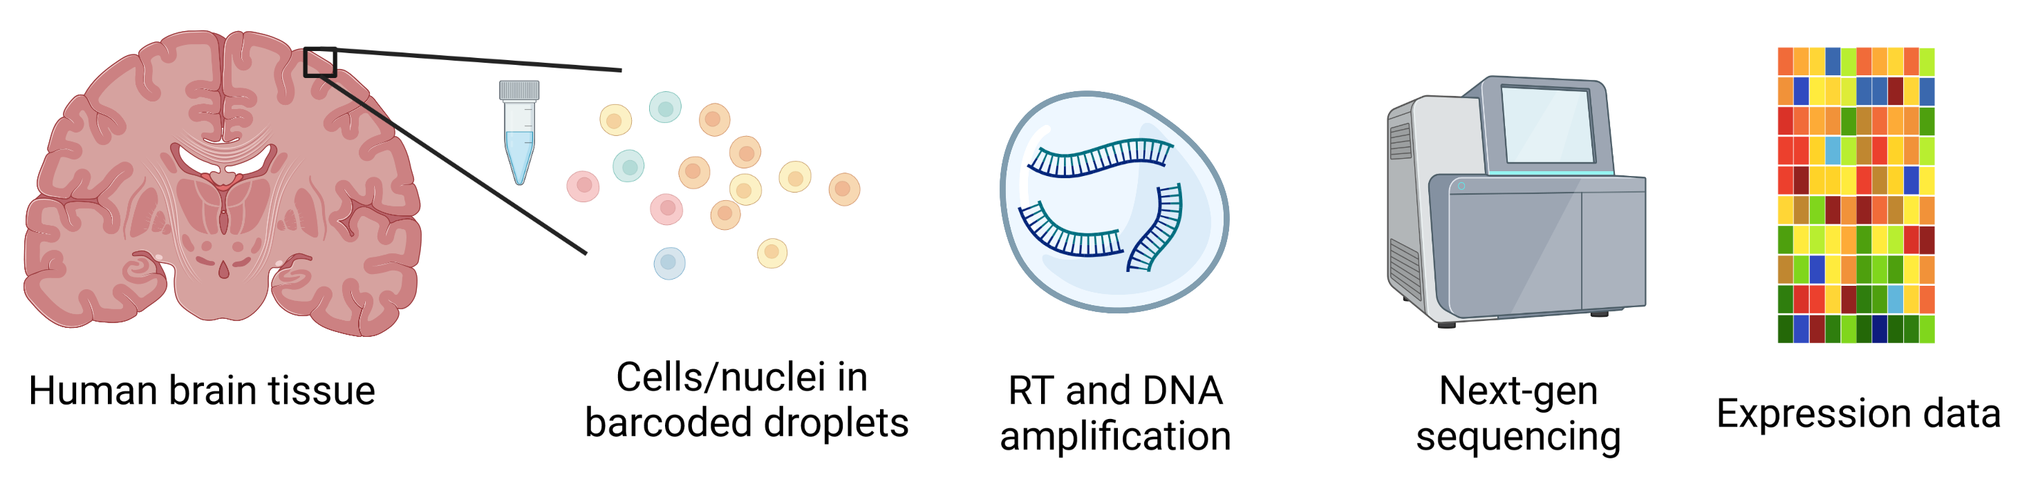
General workflow(s)
Tissue homogenization
& RNA extraction
Tissue homogenization
& protein preparation
Mass spectrometry
Protein quantification

Slide 5
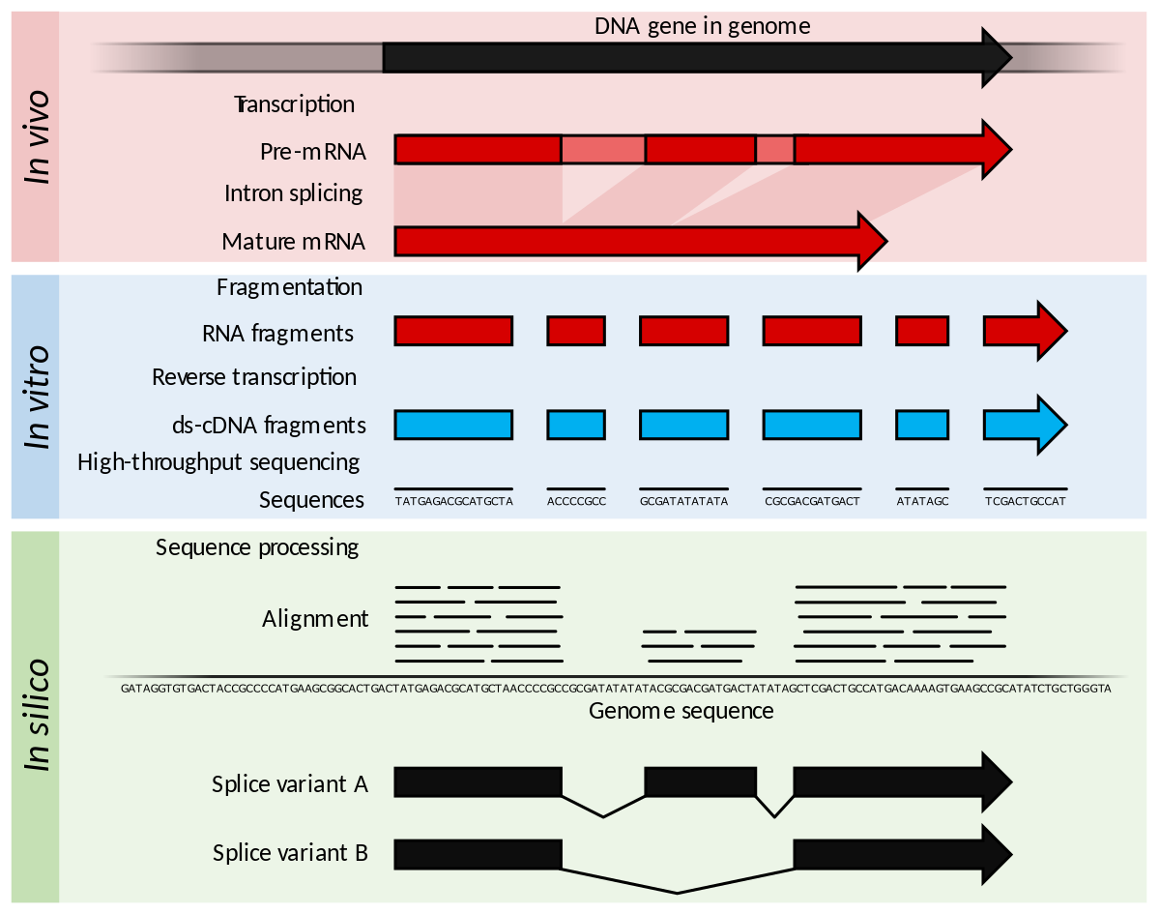
RNA-sequencing
Considerations:
Depth of sequencing (how many reads to sequence?)
Single-end or paired-end (sequence both ends or one end of each fragment?)
Selection of RNA (poly-A selection or all RNA?)

Slide 6
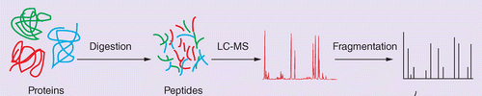
Proteomics
Luo & Muesing (2014)
Proteomics does not include an amplification step
Dynamic range tends to be much greater than for RNA-seq
Samples are often multiplexed (TMT-Mass Spec) for better sensitivity
Challenge: Identifying peptides from spectra (non-trivial)

Slide 7

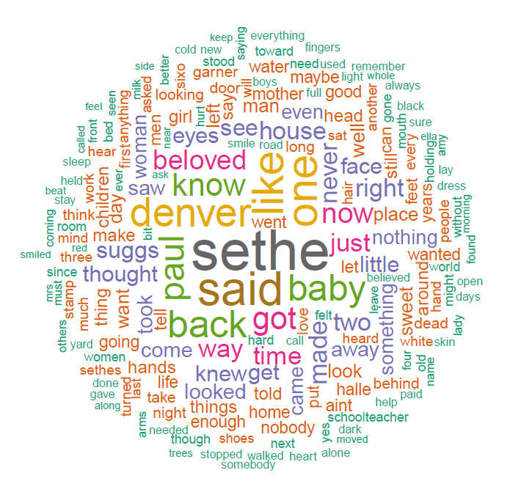
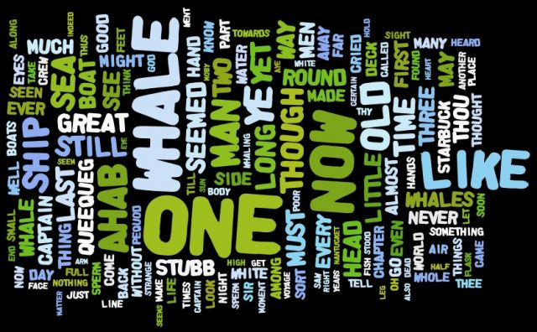
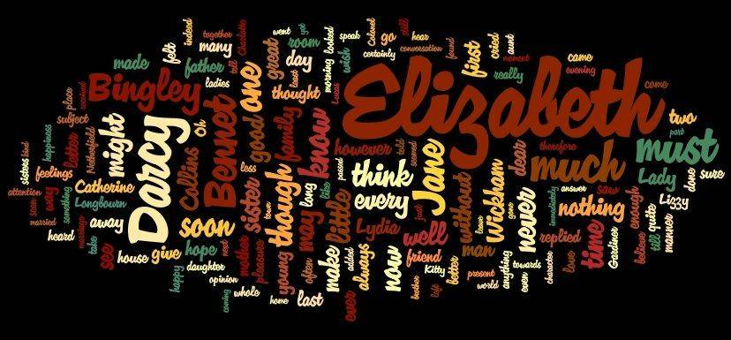
What do we measure with transcriptomics and proteomics methods?
The Art of Clean Up, Ursus Wehrli

Slide 8
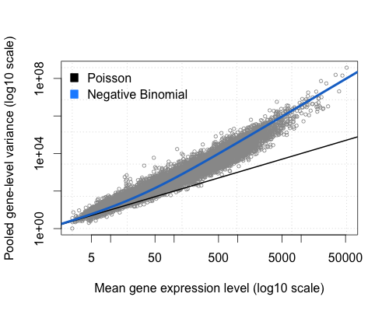
Statistical modeling of count data
Poisson distribution – measures sampling
Negative binomial distribution – allows for better modeling of RNA/protein count data
Sample 1 (reads)
Full set of molecules
Sample 2 (reads)

Slide 9
Analyzing bulk RNA-seq – general workflow
Transcriptome alignment
QC & batch correction
Normalization
Downstream analyses
Expression quantification
http://master.bioconductor.org/packages/release/workflows/vignettes/rnaseqGene/inst/doc/rnaseqGene.html
(Michael Love, Simon Anders, Vladislav Kim, Wolfgang Huber)

Slide 10
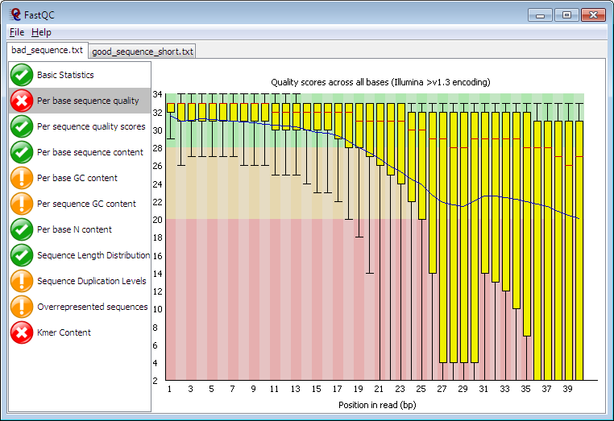
Bulk RNA-seq QC and batch correction
Common QC metrics
Total reads per library
GC bias
Per-base sequencing quality
Percentage of reads mapped
Reads mapping to genomic features
Batch correction
When batches are known:
Gene-by-gene regression by batch identity
ComBat (Empirical Bayes approach)
When unknown effects need to be accounted for:
Surrogate variable analysis (SVA)
RUVseq (Factor-based analysis)
Babraham Bioinformatics

Slide 11
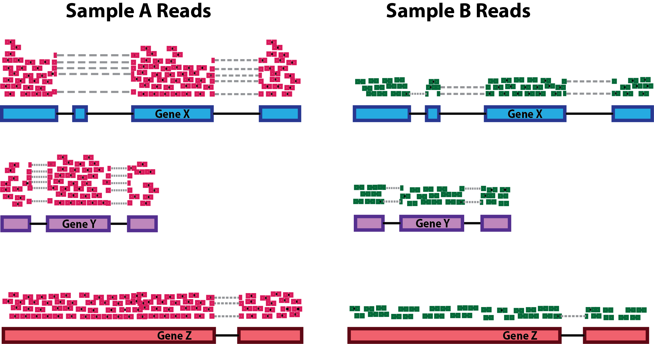
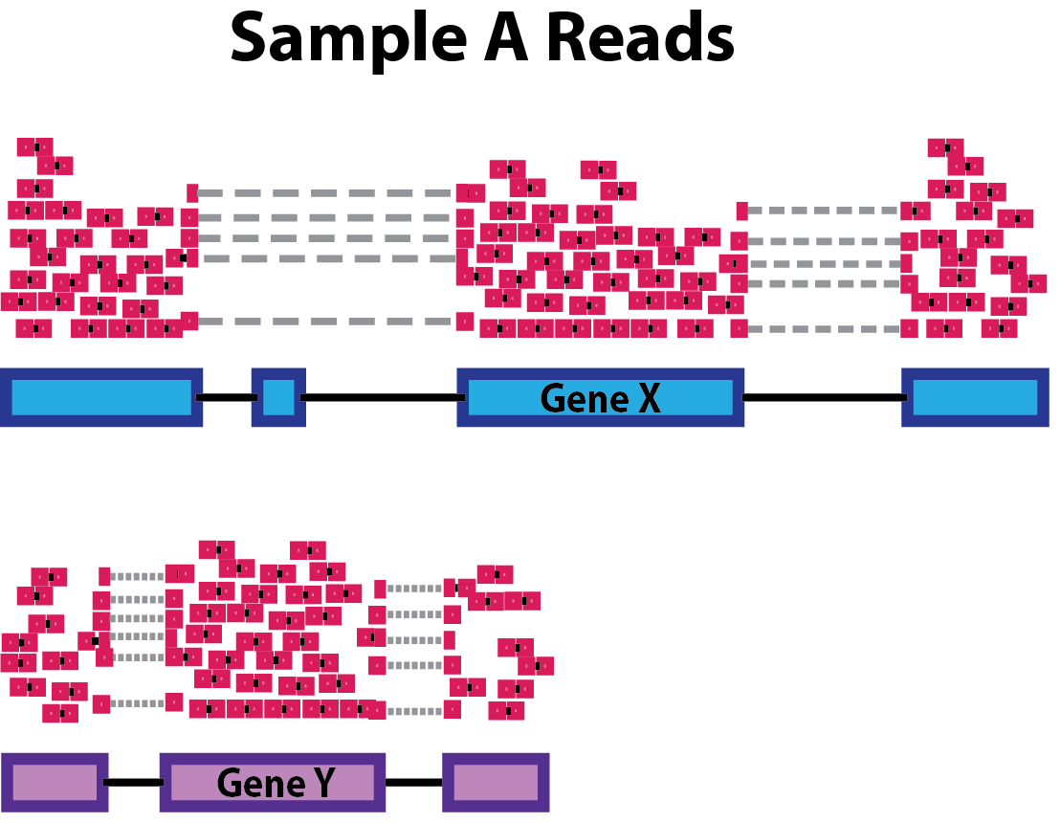
Pre-processing: Normalization
Accounting for gene length
(not done routinely anymore)
Accounting for sequencing depth
Harvard Chan Bioinformatics Core
https://hbctraining.github.io/DGE_workshop/lessons/02_DGE_count_normalization.html

Slide 12
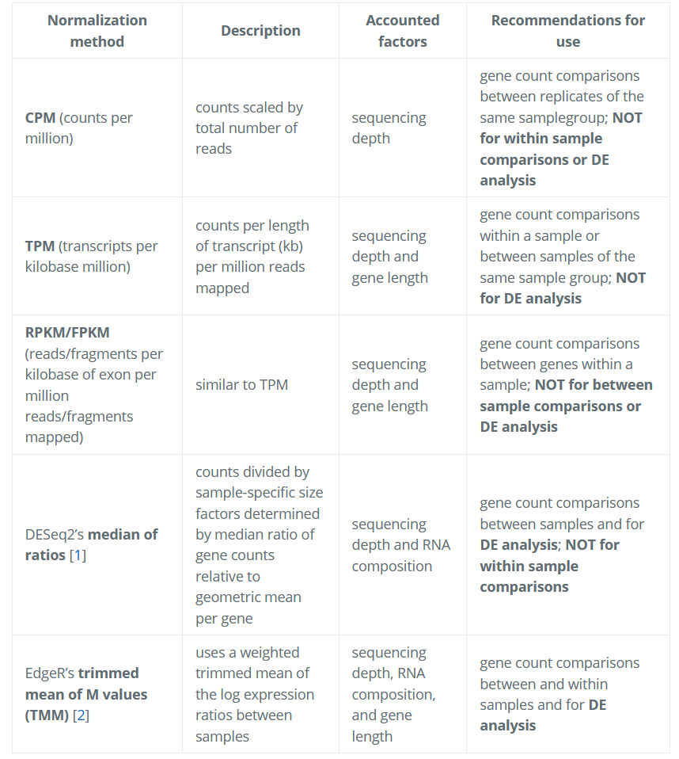
Harvard Chan Bioinformatics Core
https://hbctraining.github.io/DGE_workshop/lessons/02_DGE_count_normalization.html

Slide 13
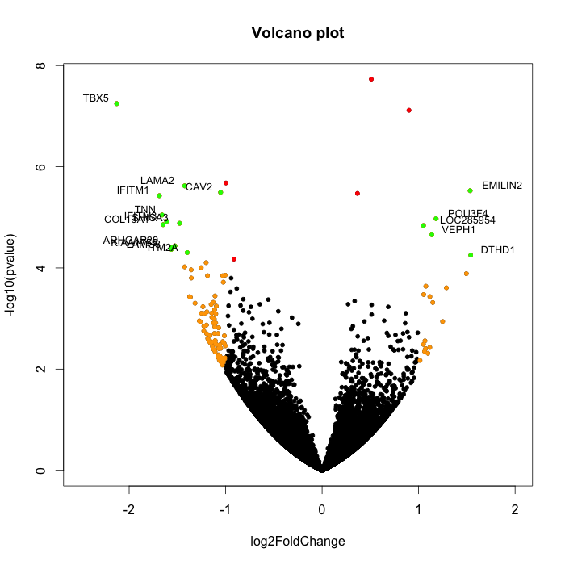
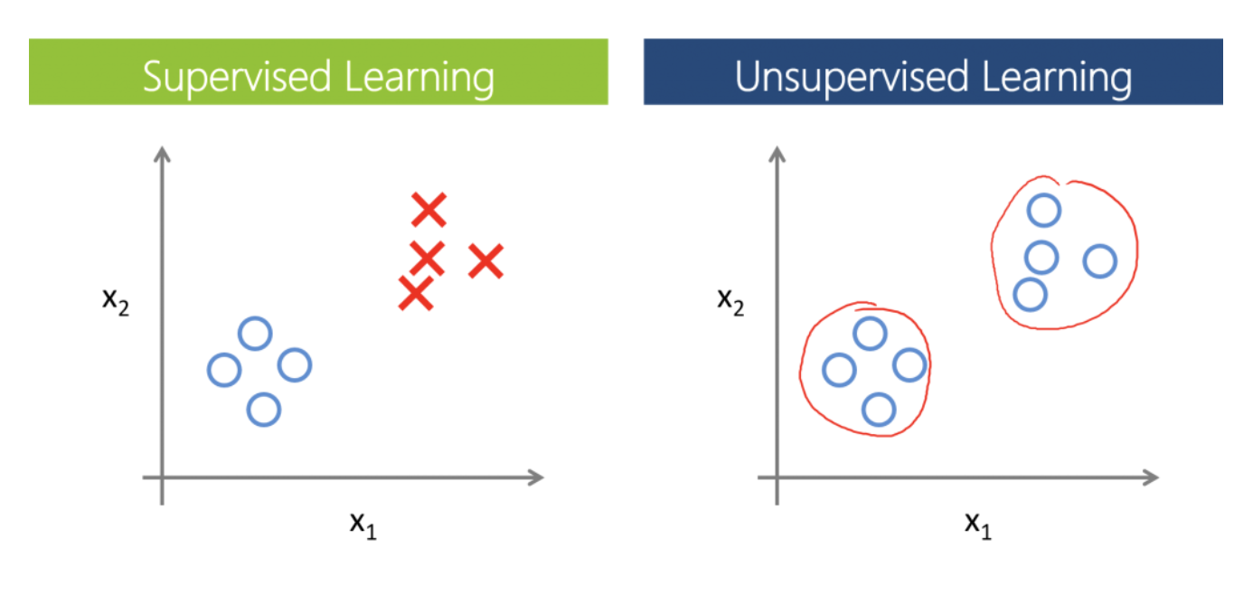
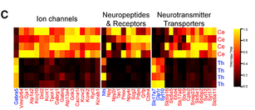
Bulk RNA-seq differential expression
Common packages:
edgeR
DESeq2

Slide 14
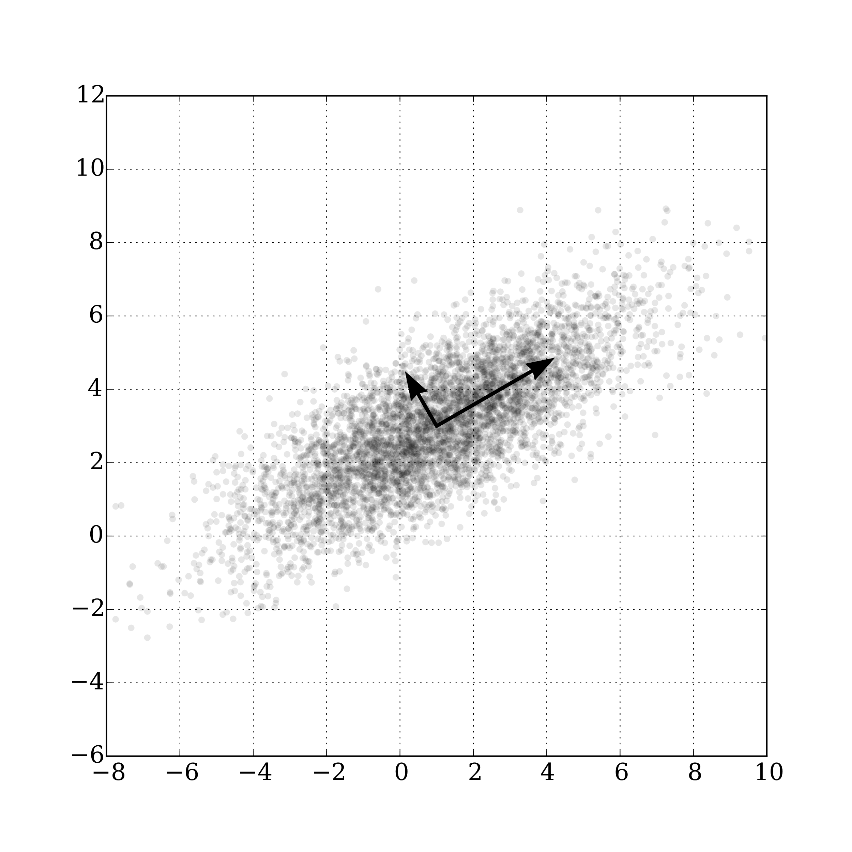
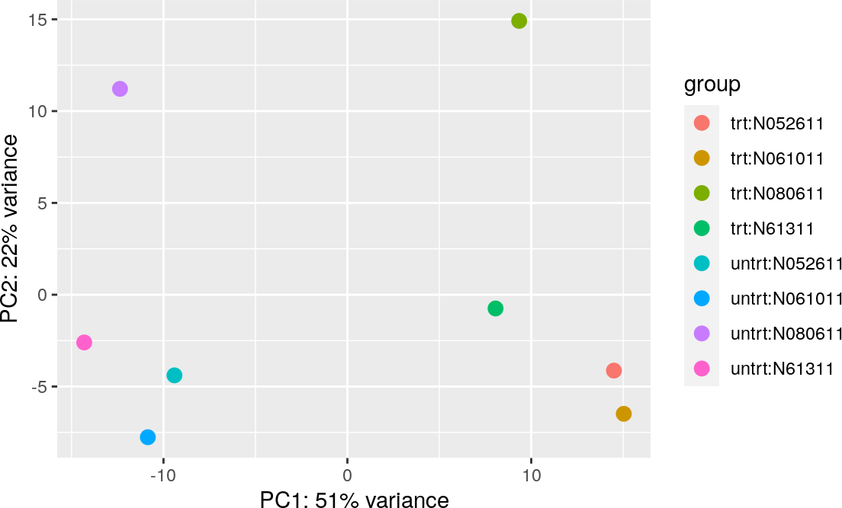
Exploratory analysis - PCA

Slide 15
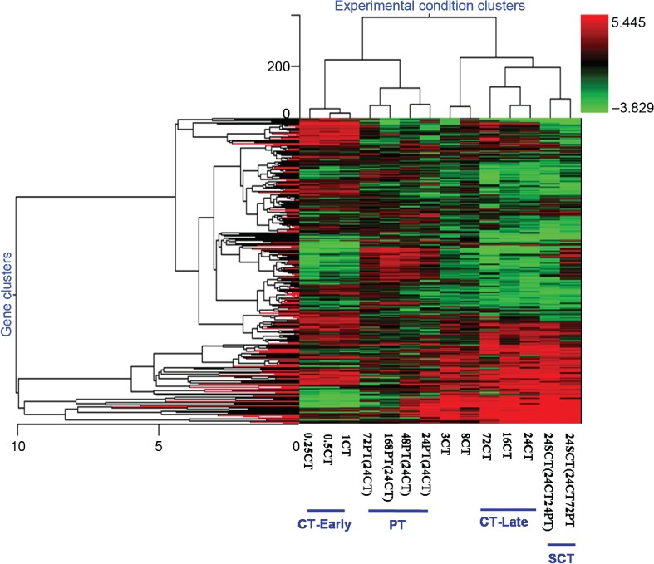
Gene and sample clustering
Identify further structure in the data, especially if samples are not easily grouped into categories
Gene clusters (“modules”) highlight co-expression patterns
With sufficiently large sample numbers, can use:
K-means clustering
Standard hierarchical clustering
Weighted Gene Co-expression Network Analysis (WGCNA)
De novo gene clusters can be used for pathway analysis

Slide 16
Summary of bulk RNA-seq analysis
Transcriptome alignment
QC & batch correction
Normalization
Downstream analyses
Expression quantification
Differential gene expression
Unsupervised approaches (PCA, gene clustering)
Integrated interpretation

Slide 17
Single-cell/single-nucleus RNA-seq
Similar to bulk transcriptomics, but now we obtain data on each cell/nucleus individually
Cells/nuclei are not labeled, so the first steps are to:
Reduce dimensionality (usually PCA)
Cluster cells into groups (cell types)
Downstream analyses can now used supervised approaches on these cell types

Slide 18
Exercise: Single-cell RNA-seq clustering in R

